Slide 1
EatzAI
NLP Chatbot Development using Dialogflow
Project Title : EatzAI – NLP Chatbot Development using Dialogflow
Supervisor : Abdullah Qamar (abdullah.qamar@vu.edu.pk)
Group ID : F24PROJECT7B8AC
Student VUID : BC200417404
GitHub: [https://github.com/Student-BC200417404/Prototype-Assignment-BC200417404]

Slide 2
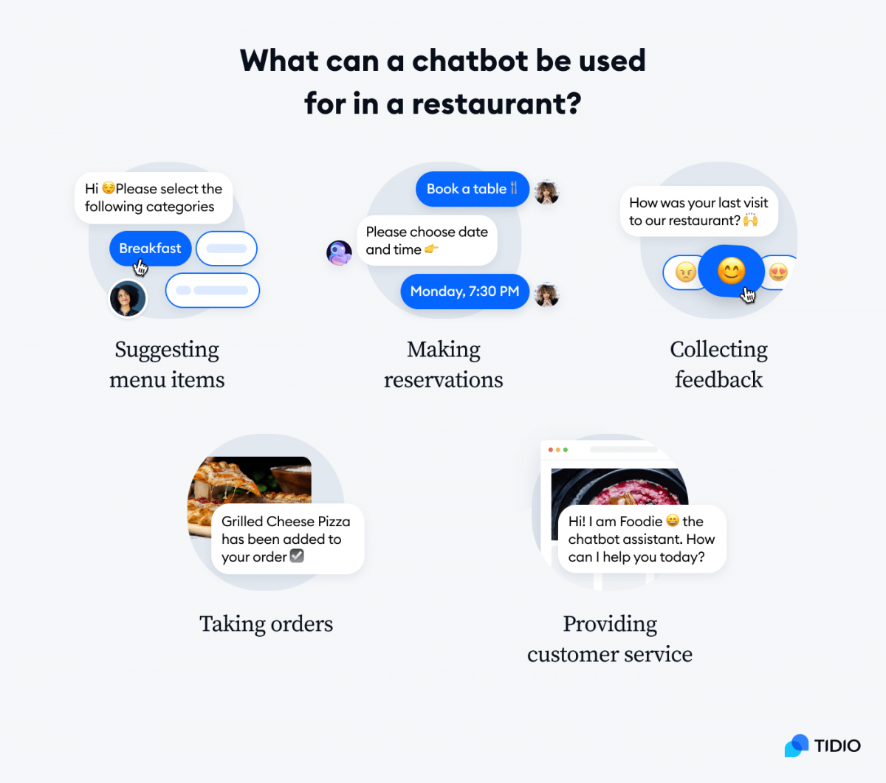
Introduction
Objective: The primary goal of the EatzAI project is to build a restaurant chatbot using Google Dialogflow that automates key operations to enhance the dining experience.
Table Reservations: Simplifying the booking process.
Order Placement: Streamlining how customers place orders.
Menu Navigation: Assisting users in exploring menu options.
Customer Support: Providing instant answers to queries.
User Experience Improvement: EatzAI aims to improve user experience by delivering instant and accurate responses, ensuring customer satisfaction and operational efficiency.

Slide 3

Project Scope
Functional Areas: The project encompasses several functional areas, including:
Table Reservations: Enabling users to book tables effortlessly.
Order Management: Facilitating order placements and tracking.
Menu Navigation: Helping users navigate through the menu.
Customer Support: Addressing FAQs and creating support tickets.
Channels: EatzAI will operate through:

Slide 4
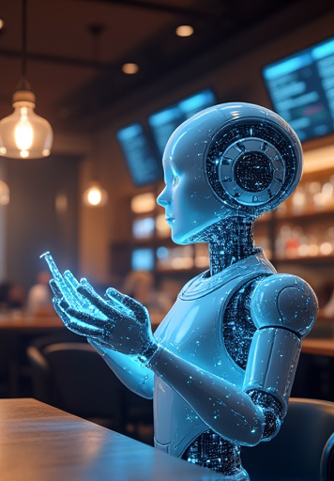
Project Objectives
Goals of EatzAI:
Automate Standard Interactions: Enhance efficiency by automating customer interactions.
Real-Time Synchronization: Ensure the chatbot is synchronized with restaurant systems for up-to-date information.
User-Friendly Interface: Provide an intuitive and seamless interface for customers.
Secure Authentication: Implement secure user authentication and role-based access.

Slide 5
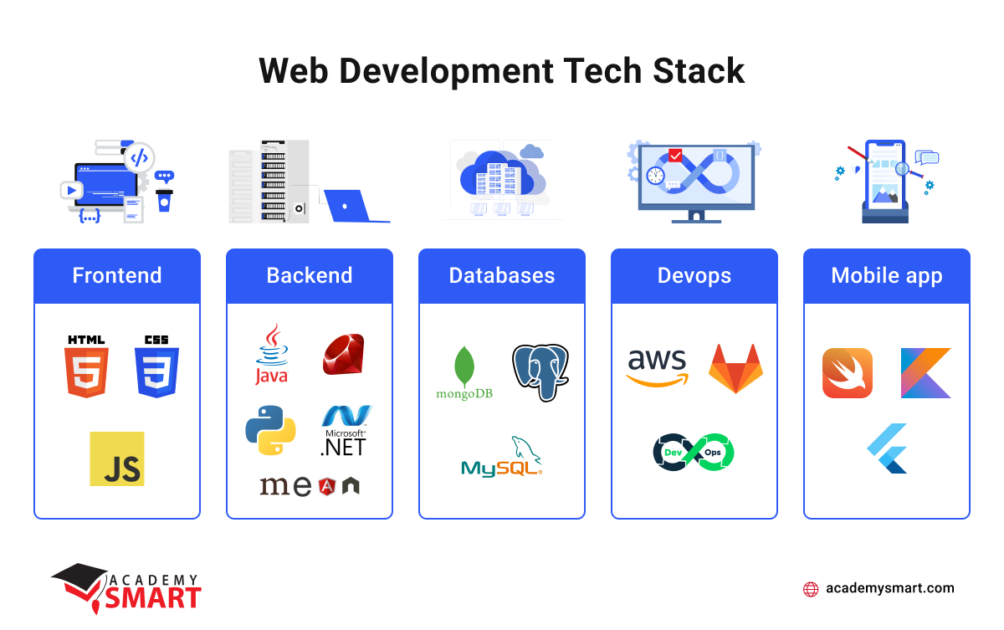
System Overview
Technology Stack
The EatzAI project utilizes the following technologies:
NLP Engine: Google Dialogflow for natural language processing.
Backend: Python
Database: MySQL for data management.
Frontend: PHP
Architecture Flow: The architectural flow of EatzAI is as follows: User → Chatbot → Intent Detection → Action/Response.

Slide 6
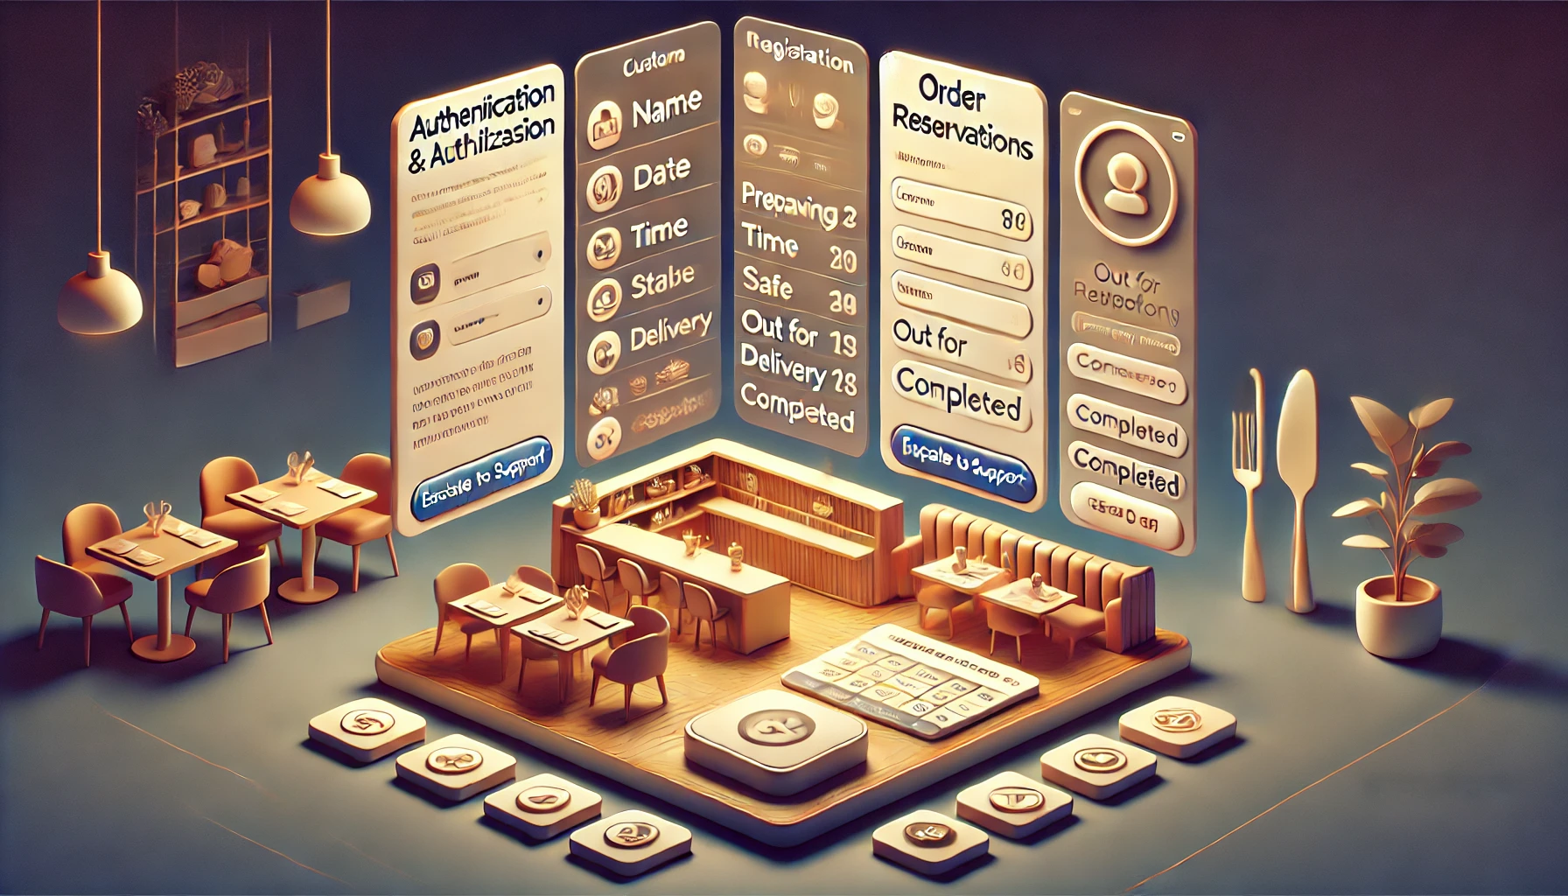
Functional Requirements
Detailed Functional Requirements:
Authentication & Authorization: User registration and role-based access control.
Table Reservations: Collect reservation details and generate unique booking IDs.
Order Management: Accept orders, calculate totals, and track order status.
Menu Navigation: Provide detailed menu information and personalized recommendations.
Customer Support: Handle FAQs and escalate complex issues via support tickets.

Slide 7
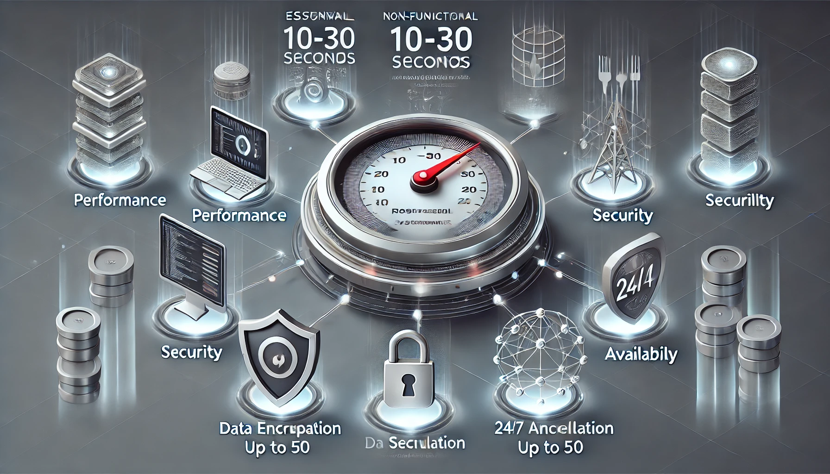
Non-Functional Requirements
Essential Non-Functional Requirements:
Performance: System should respond within 10-30 seconds.
Scalability: Support up to 50 concurrent users without performance degradation.
Security: Implement data encryption and robust user data protection measures.
Availability: Ensure 24/7 access on both web and mobile platforms.

Slide 8

System Flow Diagram
Interaction Representation
The system flow diagram illustrates the interaction between user input, Dialogflow processing, and subsequent system responses. This visual representation clarifies the workflow for: Reservations: User inputs reservation details. Order Placements: User places an order. Support Queries: User seeks assistance.

Slide 9
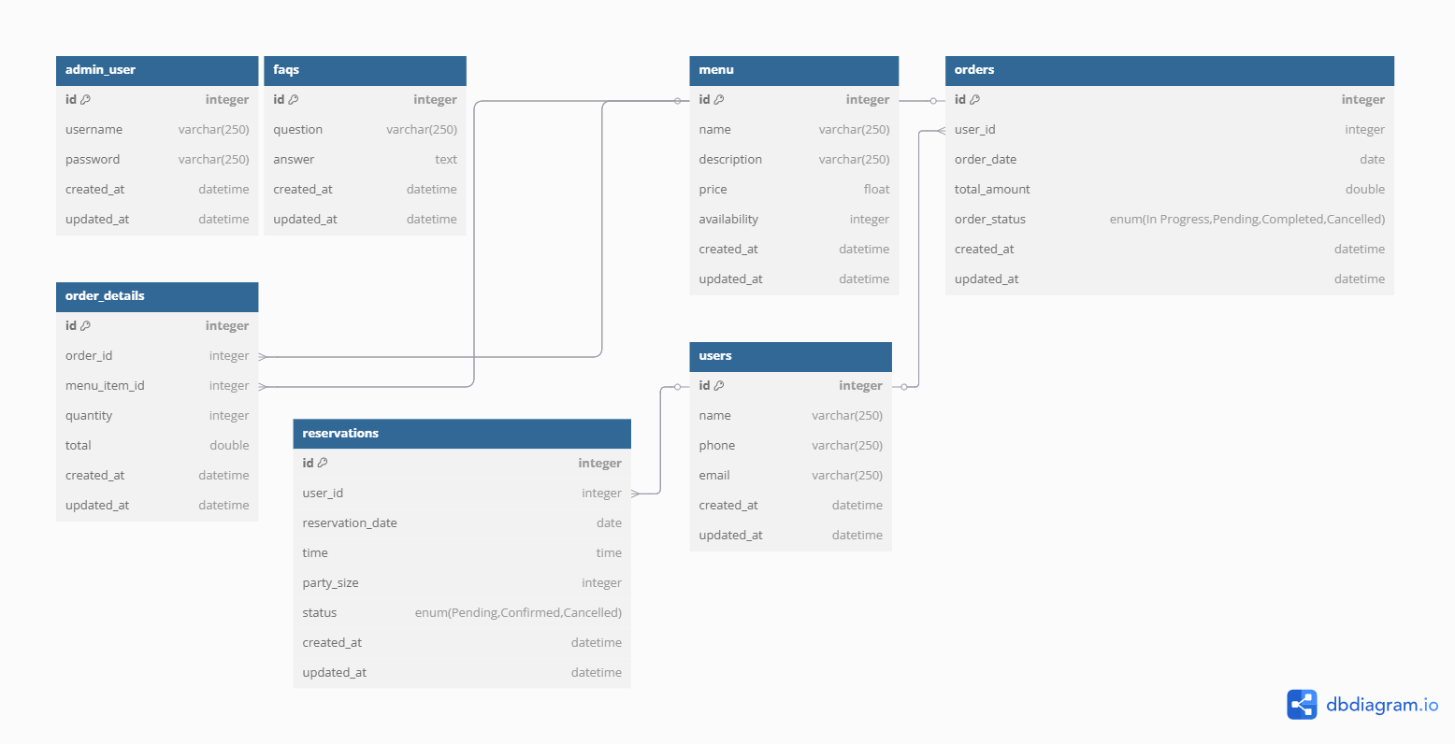
Database Schema Design

Slide 10
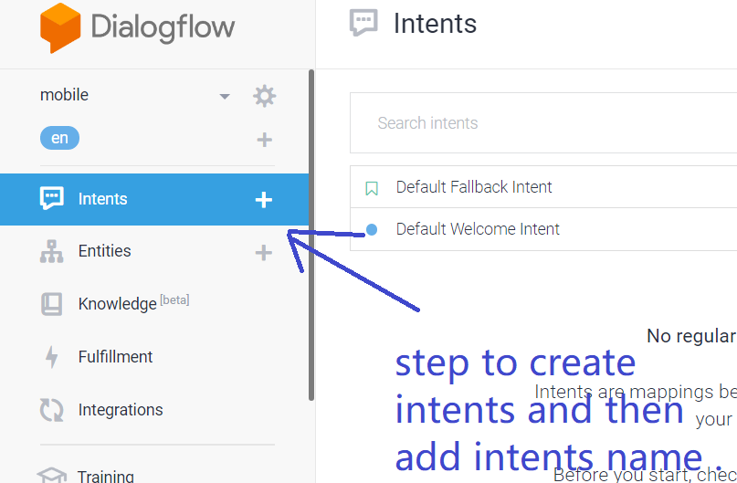
Dialogflow Design
Intent and Entity Management: The Dialogflow design includes:
Clear Intents: Well-defined intents for various customer queries, such as Order Status and Product Information.
Entity Extraction: Dynamic input extraction (e.g., Order ID, Date) to enhance user interactions.

Slide 11
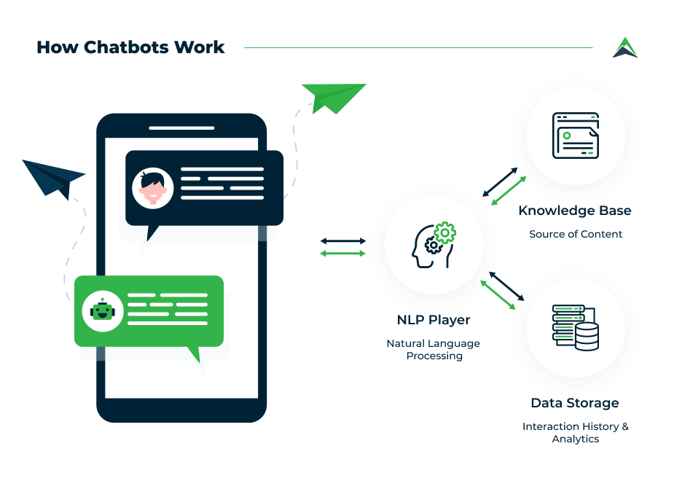
User Interaction Flow (Example: Order Status)
Interaction Example
User: "Where’s my order?" Bot: "Please provide your Order ID." The system looks up the Order ID and responds with the current status. Follow-up: "Need help with anything else?"

Slide 12

Key Dialog Scenarios
Critical Dialog Scenarios:
Greeting & Onboarding: Welcoming users and guiding them through initial interactions.
Order Status: Providing real-time tracking of orders.
Product Information: Assisting users with menu navigation and details.
Technical Support: Generating support tickets for complex issues.
Conversation Closure: Gracefully exiting conversations and prompting for feedback.

Slide 13
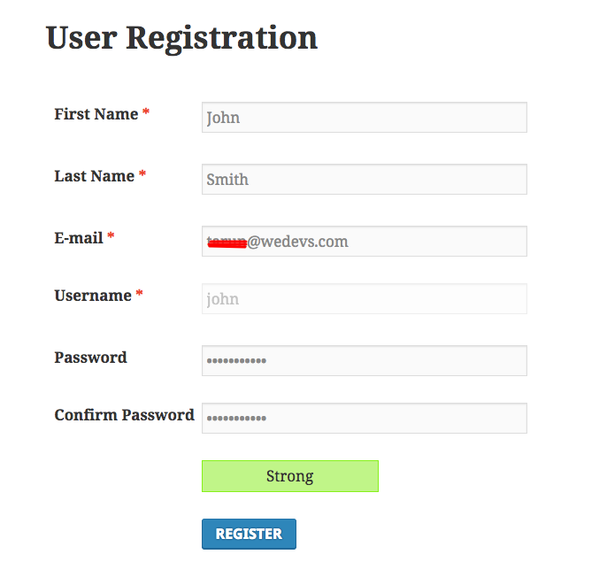
Authentication & Profile Management
Features:
Secure User Registration: Ensuring safe user sign-up processes.
Role-Based Access: Different dashboards for Admin and Customer roles.
Implementation: Backend Logic: Using PHP to manage user authentication. Data Protection: Employing database encryption for sensitive information.

Slide 14
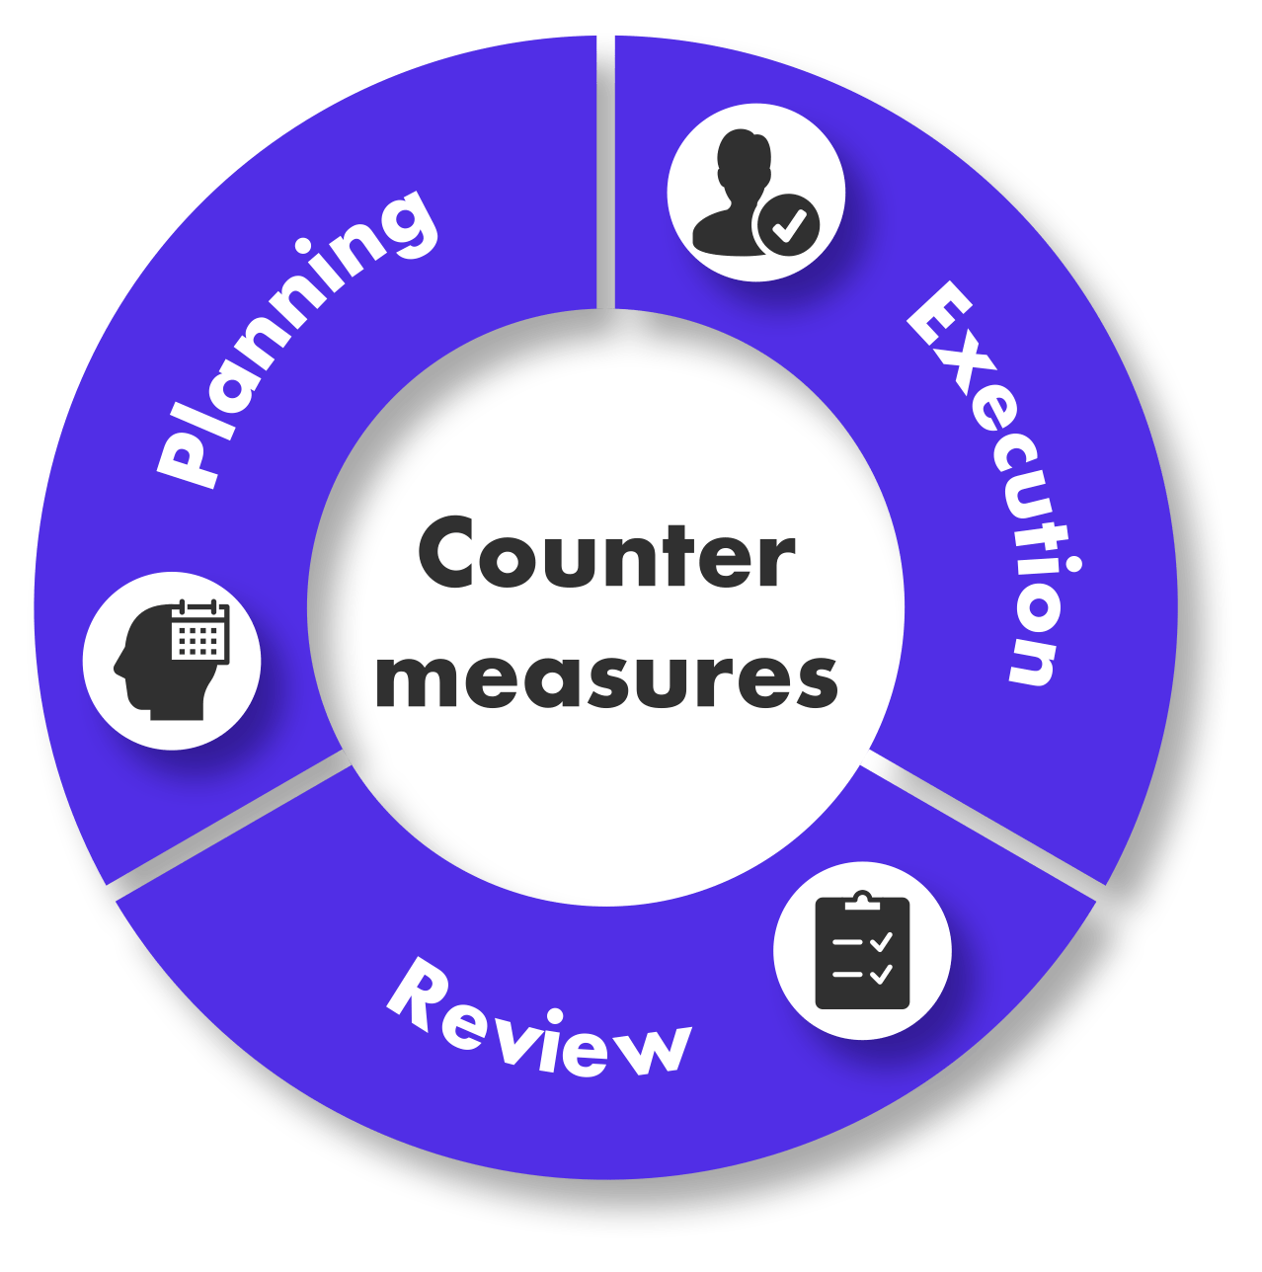
Error Handling & Fallback Mechanisms
Error Management Strategies:
No Intent Recognized: "I didn’t understand. Could you rephrase your question?"
Invalid Input: "Please provide a valid Order ID for assistance."
Multiple Intents: "I detected multiple requests. Which one should I process first?"

Slide 15
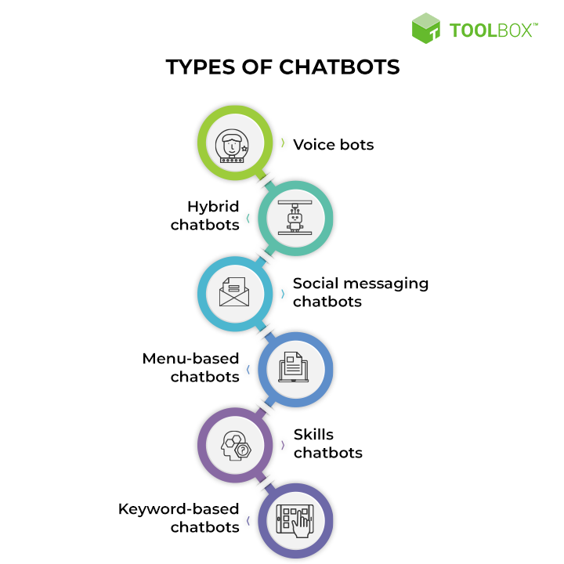
Prototype Deliverables
Tangible Outputs:
Functional Chatbot: Integrated with Google Dialogflow.
User Authentication System: Including login and dashboard functionalities.
Database Schema: Designed with functional CRUD operations.
GitHub Repository: Source code and comprehensive documentation available for review.

Slide 16
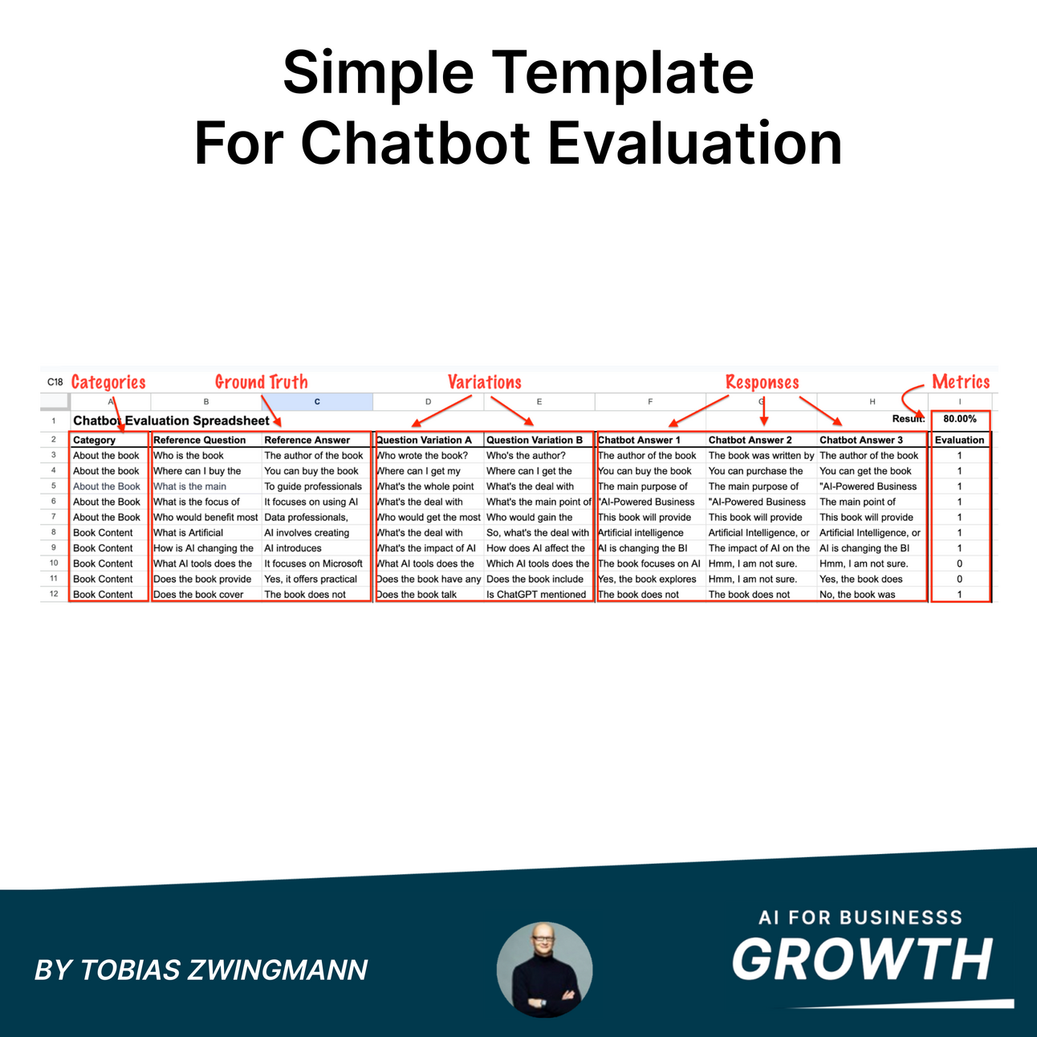
Assessment Criteria
Evaluation Criteria:
Functionality: All core features must be fully implemented.
Usability: The chatbot interface should be intuitive and responsive.
Database Integration: Clear schema and established relationships must be evident.
Dialogflow Accuracy: High precision in intent recognition and handling is essential.

Slide 17
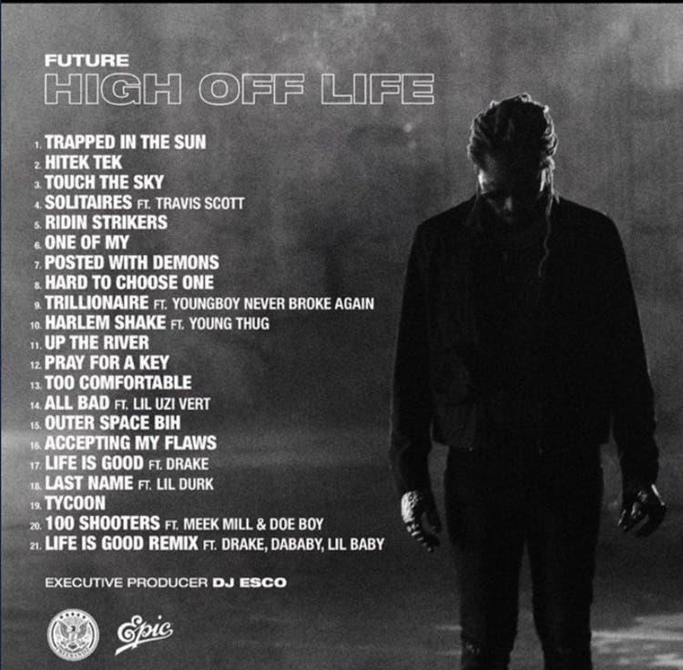
Future Enhancements
Suggestions for Future Features:
Payment Gateway Integration: For seamless transaction processing.
Multilingual Support: To cater to a broader audience.
Personalized Recommendations: Based on user interaction history to enhance user engagement.

Slide 18

Conclusion
Summary of EatzAI Project: EatzAI represents an innovative NLP-based chatbot aimed at improving restaurant automation and user experiences.
Development Process: Our hybrid approach ensures a well-structured yet adaptable development cycle, enhancing operational efficiency while delivering a superior user experience.
Final Thoughts: The successful implementation of EatzAI will not only streamline restaurant operations but also significantly enhance customer satisfaction through improved interaction and service delivery.

